Slide 1




Big Data Analytics Project
TEAM PURPLE : PHASE-1

Slide 2

Requirements
Case 1
determine the three airports with the lowest delay time (in hours)
Case 2
determine the three carriers with the lowest delay time (in hours) for your year
Case 3
determine overall which type of delay (arrivals or departures) is the lowest for the team’s airports
Conclusion
Collaborate on the presentation deck and create a conclusion slide that compare the results of tasks d, e and f within your team and pick the airport and carrier with the lowest delay
for your year

Slide 3

SARAH ANNIE GEORGE
Year – 2005
Operating System: MAC

Slide 4


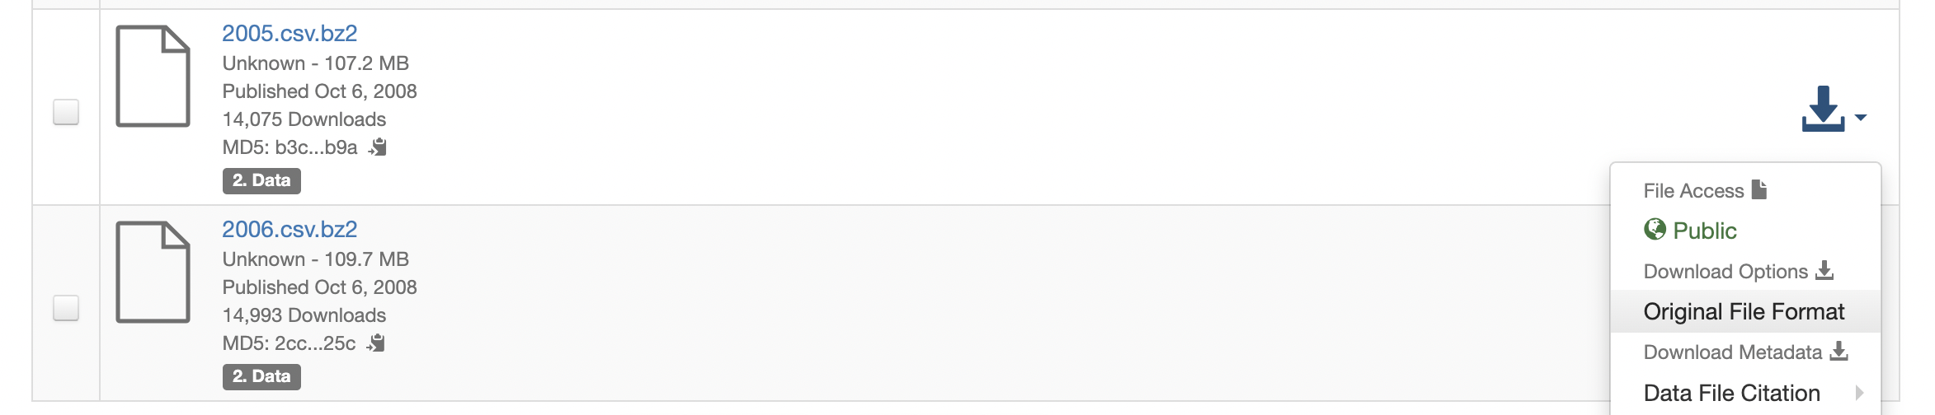
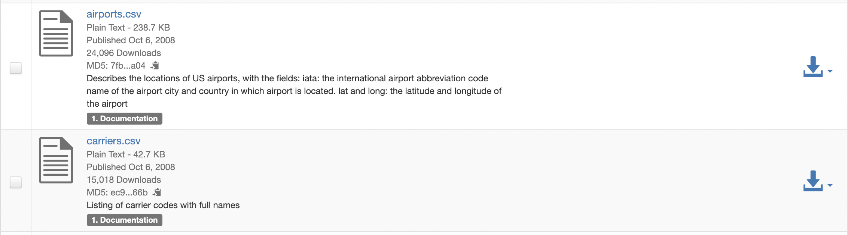
SARAH ANNIE GEORGE Data source
Airline On Time Data
The data represents flight arrival and departure details for all commercial flights within the USA for the year 2005
Download Link -
Harvard - Airline On Time Data
2005 data: Used ”The Unarchiver” s/w to unzip .bz2 file format
Airports & carriers data:

Slide 5
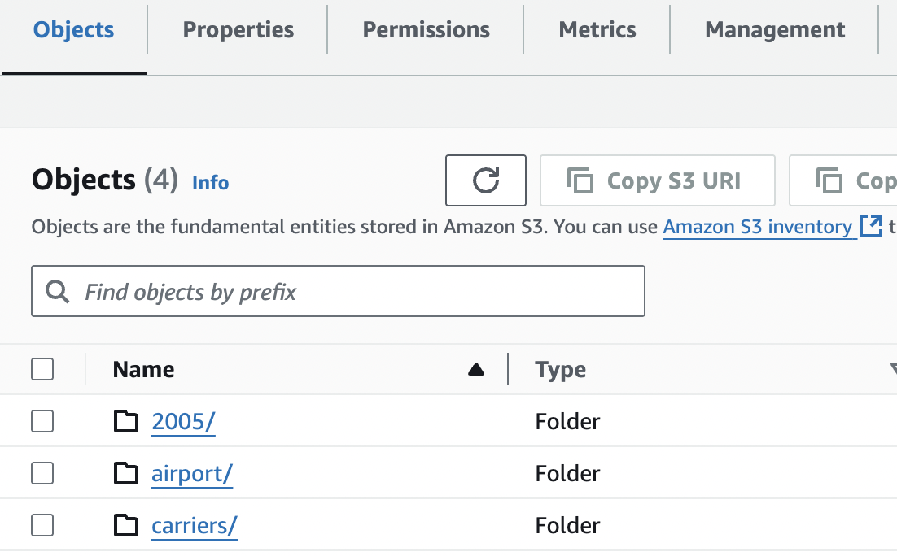
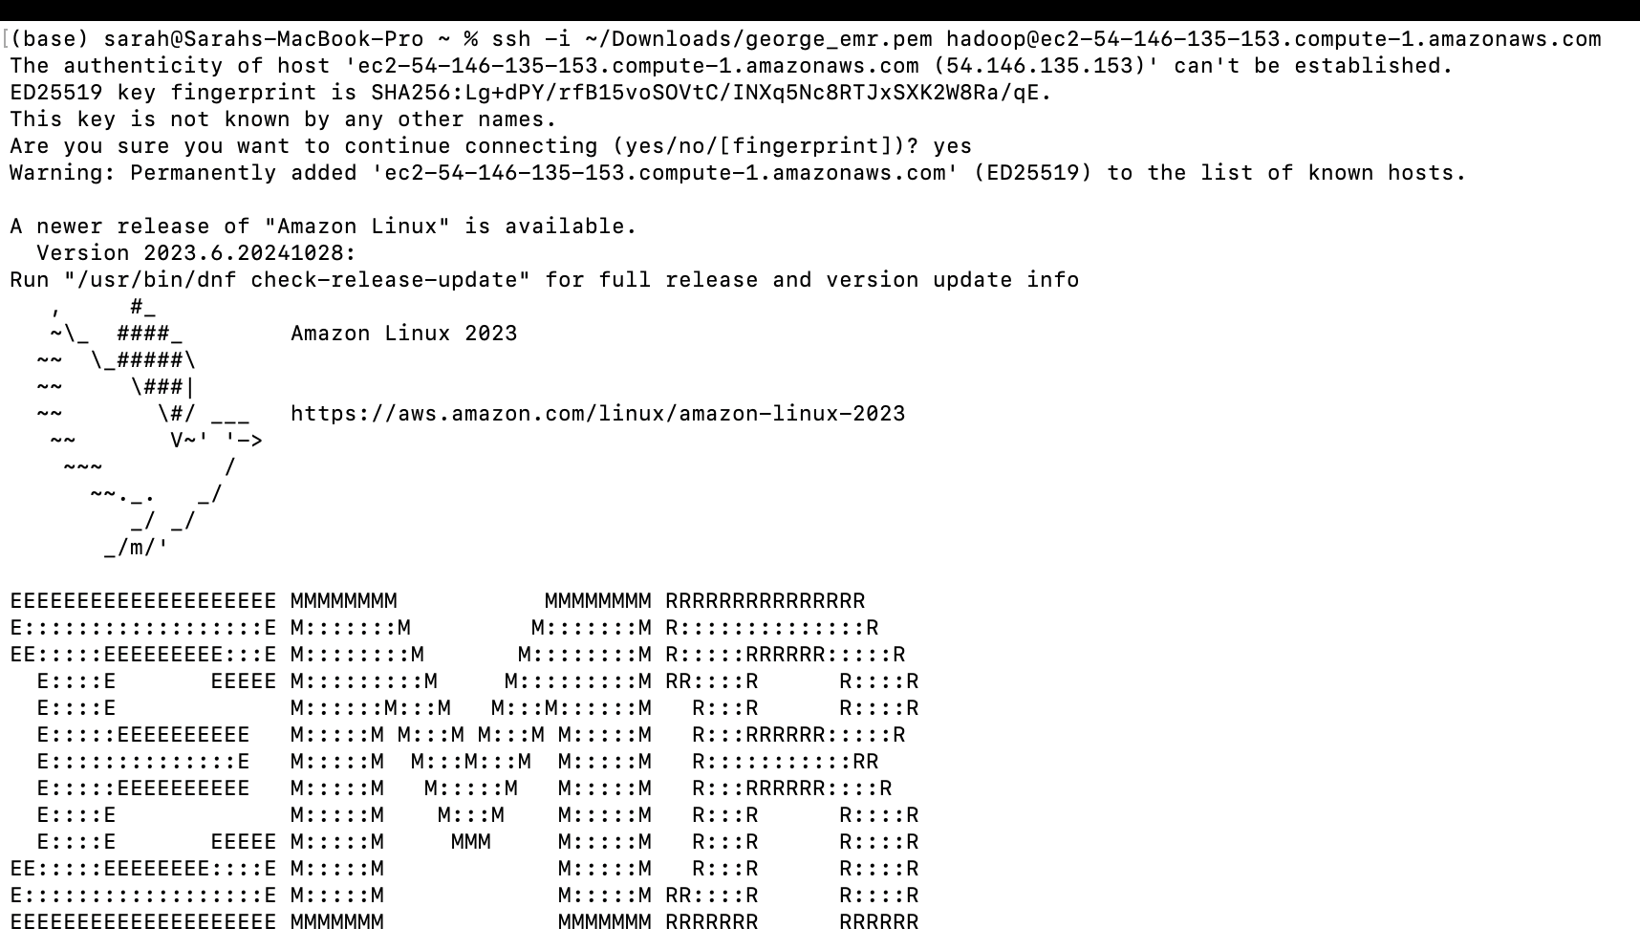
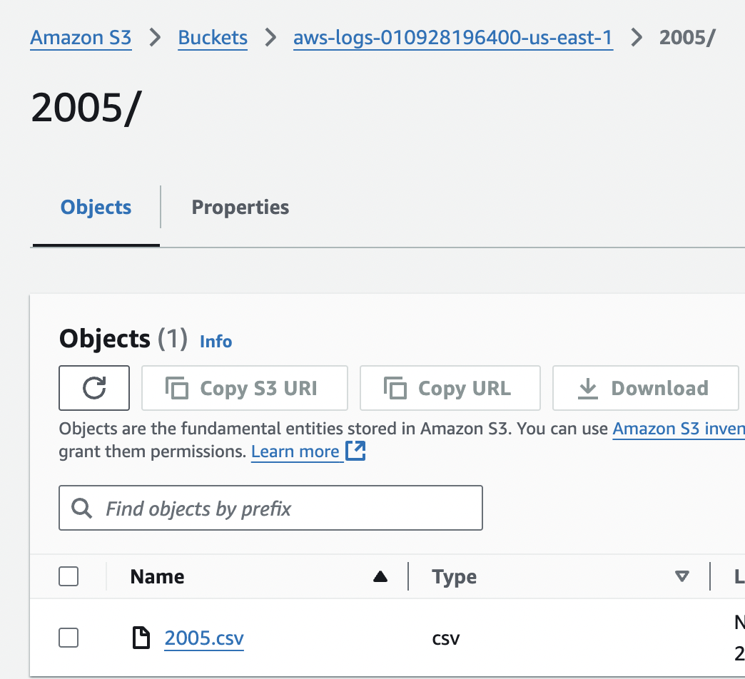
SARAH ANNIE GEORGE FILE TRANSFER Using AWS S3 as an intermediate for upload of file to the EMR server
Step 1: Upload files to S3 bucket in separate folders
Step 2: After getting the public DNS of my EMR cluster’s master node, SSH into EMR cluster to interact with the cluster environment

Slide 6
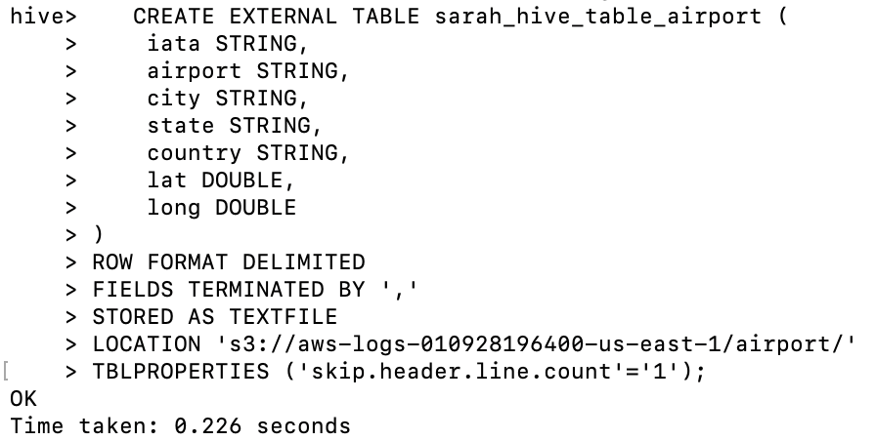
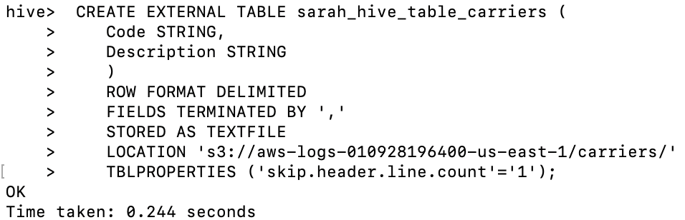
SARAH ANNIE GEORGE HIVE TABLE CREATION & DATA LOADING FROM S3 TO HIVE
Airports:
Carriers:
I am using external table to directly query data stored on S3 without the need to import it into Hive’s managed storage which is efficient for large datasets where importing data could be time-consuming and costly.
Hive treats header as a row so I am skipping header line as we do not need that as a row & also so that the table count is not affected.
Since my data type had integer of int64 data types and floating numbers of float64 data types, I used BigInt and Double which are the respective data types for hive. For object data type I used String as that is the equivalent in Hive.

Slide 7
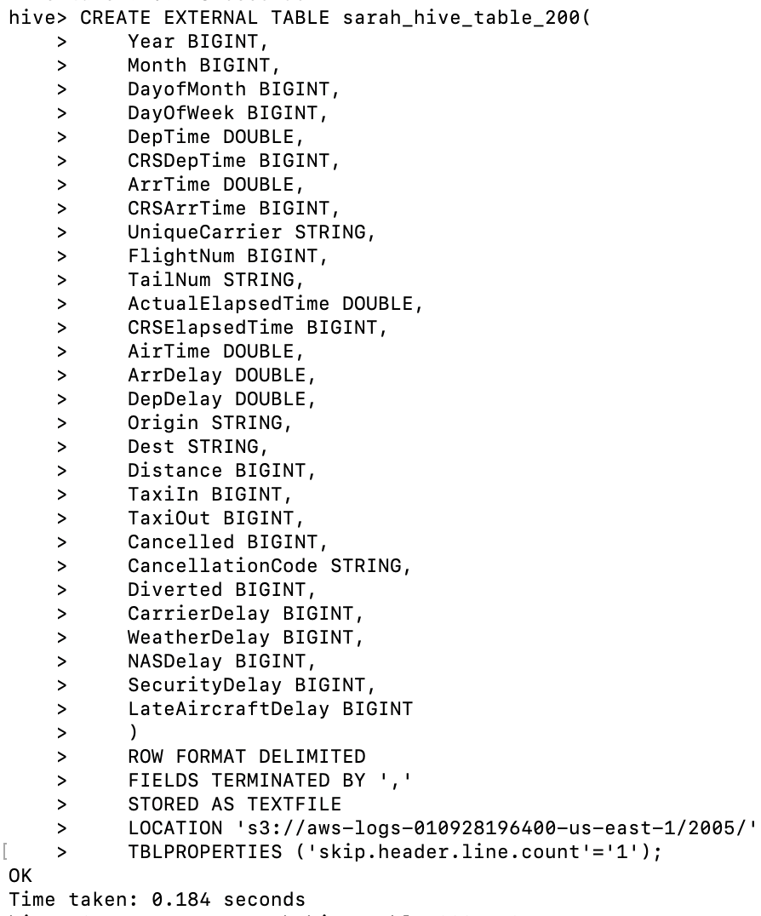
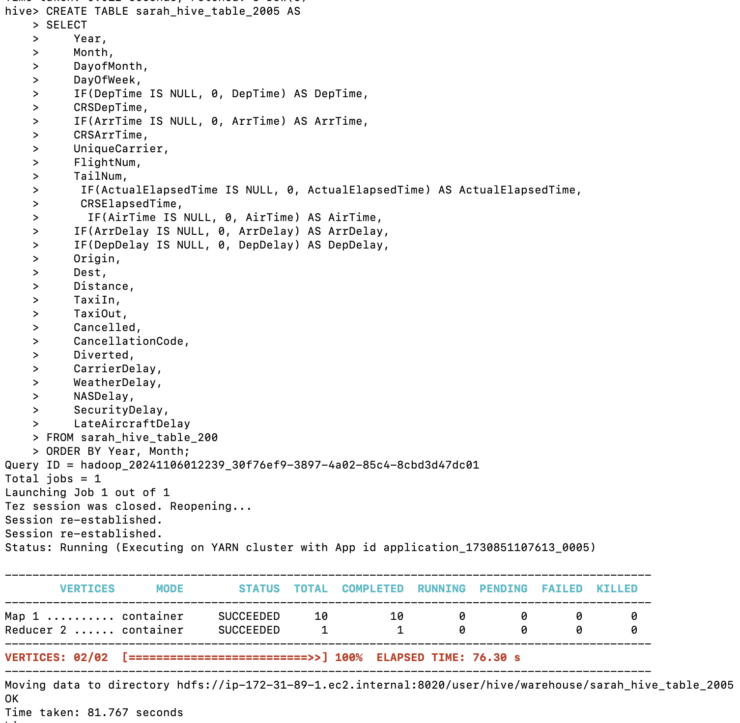
SARAH ANNIE GEORGE CREATING 2005 HIVE TABLE & REPLACING NULL WITH 0
Step 1: Create a temporary table with all 2005 csv data
Step 2: Create 2005 table & insert values from temporary table to the 2005 table & whilst doing that replace nulls with 0

Slide 8
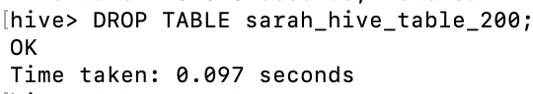
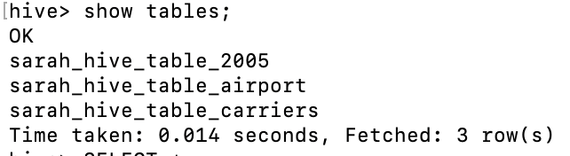
SARAH ANNIE GEORGE: CREATING 2005 HIVE TABLE & REPLACING NULL WITH 0
Step 3: Drop the temporary table
Step 4: Finally, see all current tables created
Conclusion: In general, Hive avoids nulls when doing aggregation. NULL could mean no value, not reported or unknown value so I replaced null with 0(zero) to make data more accurate & consistent .
Eg: summing a number(10) + NULL will return NULL which is what we do not want in the queries

Slide 9
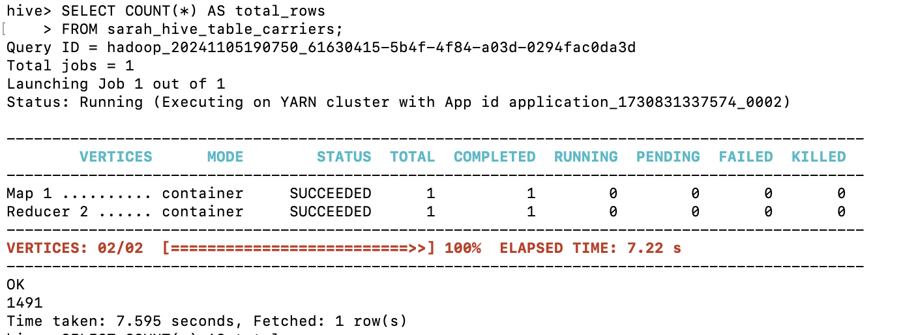
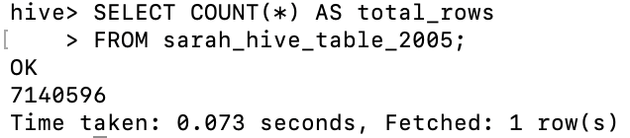
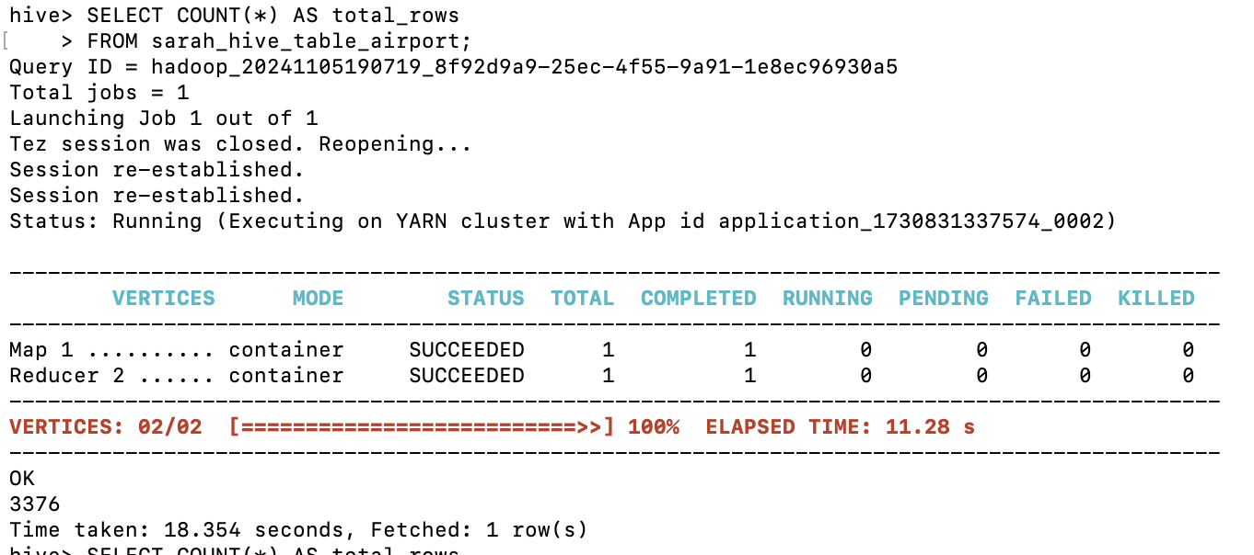
SARAH ANNIE GEORGE COUNT OF ALL ROWS IN THE 3 TABLES
Carriers:
2005:
Airports:
No of rows in each table:
1491 rows in Carriers table
3376 rows in Airports table
7140596 rows in 2005 table

Slide 10
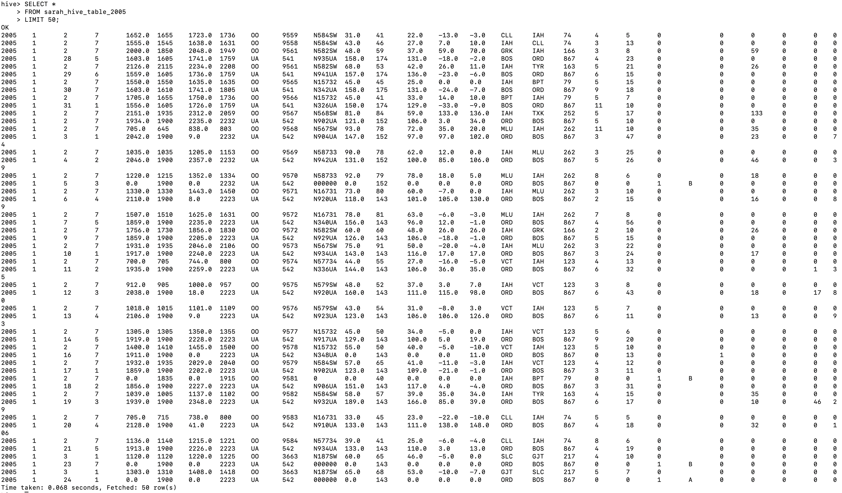
SARAH ANNIE GEORGE SAMPLE OF LOADED ROWS(50) – 2005 TABLE

Slide 11
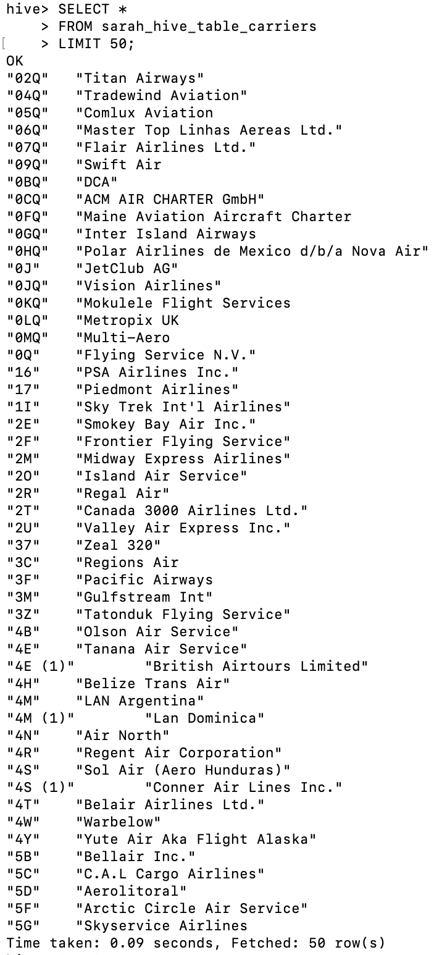
SARAH ANNIE GEORGE SAMPLE OF LOADED ROWS(50) – CARRIERS TABLE

Slide 12
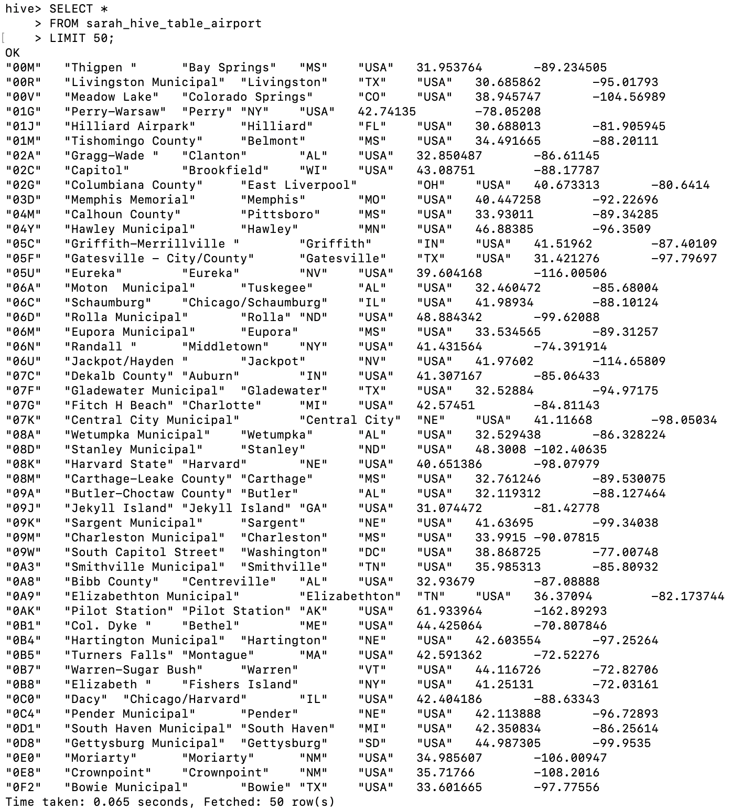
SARAH ANNIE GEORGE SAMPLE OF LOADED ROWS(50) – AIRPORTS TABLE

Slide 13

SARAH ANNIE GEORGE CASE 1

Slide 14
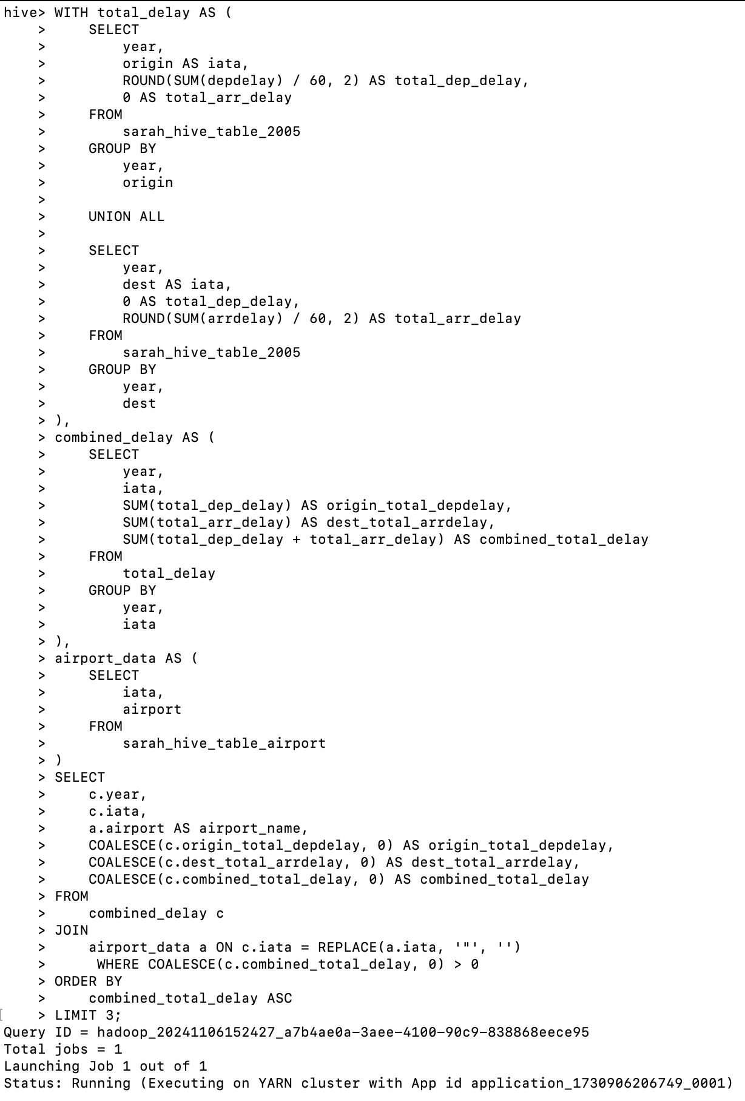
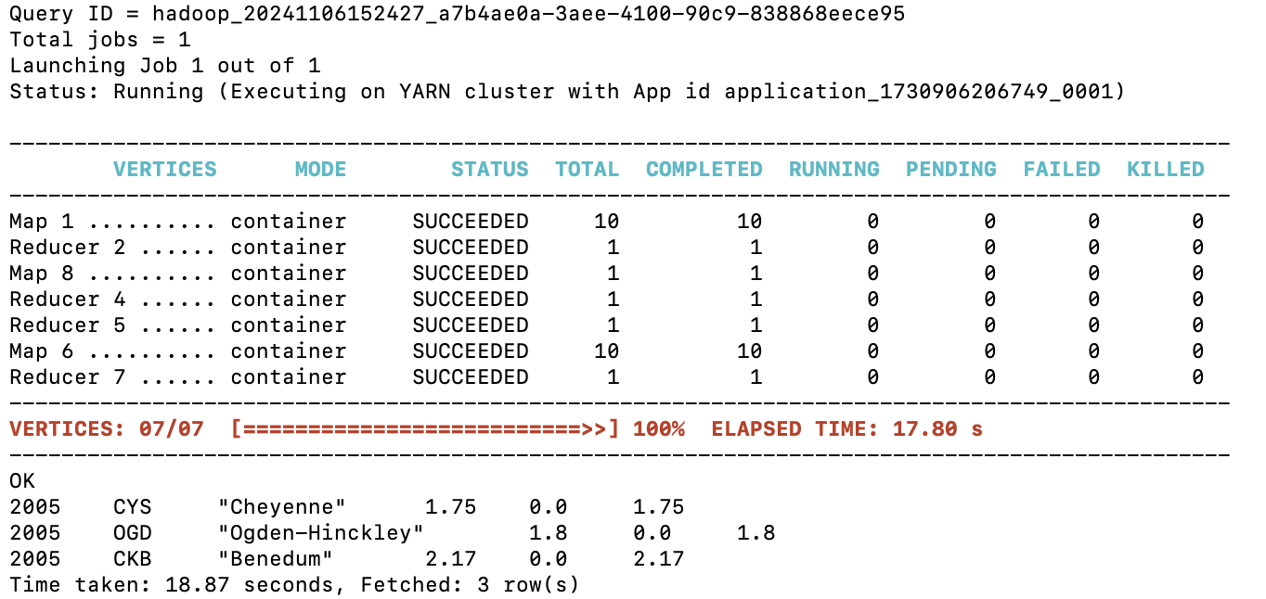
Determine the three airports with the lowest delay time (in hours) for your year
Calculating overall delay performance by Airports:
Total Origin departure delay time & destination arrival delay time from the same airport. We get a clear total of delays related to that specific airport by summing both its departure and arrival delays.

Slide 15

RESULT - The three airports with the lowest delay time (in hours)
Year | Airport Name | Origin Total Departure time delay (in Hours) | Destination Total Arrival Time Delay (in Hours) | Total Delay (In Hours)
2005 | Cheyenne | 1.75 | 0.0 | 1.75
2005 | Ogden-Hinckley | 1.8 | 0.0 | 1.8
2005 | Inyokern | 2.17 | 0.0 | 2.17
Conclusion:
Flights arriving at Cheyenne, Ogden-Hinckley, and Inyokern airports experience no arrival delays (0.0 hours). This may indicate that aircraft arriving at these airports arrived early or on schedule.
For planes leaving from each airport, there are some departure delays (between 1.75 and 2.17 hours). This suggests that there have been occasional flight departure delays at these airports, which may be the result of different logistical or operational issues.
The airports with the longest overall delays are Inyokern (2.17 hours), Ogden-Hinckley (1.8 hours), and Cheyenne (1.75 hours).This suggests that if minimizing delays is a top concern, Inyokern may need to pay more attention to departure management.

Slide 16
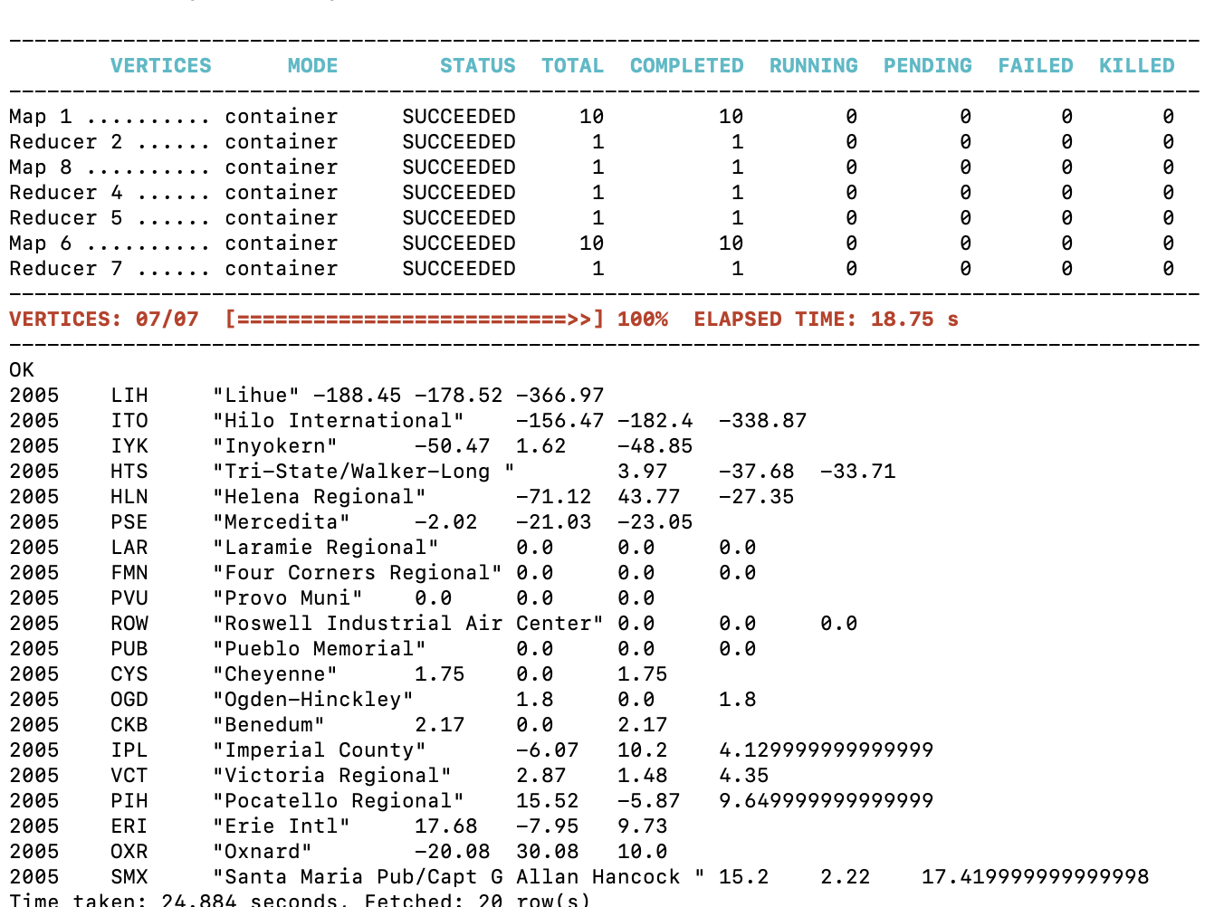
Determine the three airports with the lowest delay time (in hours) for your year
Additional – see all 20 airports delay time

Slide 17
SARAH ANNIE GEORGE CASE 1 : ADDITIONAL

Slide 18
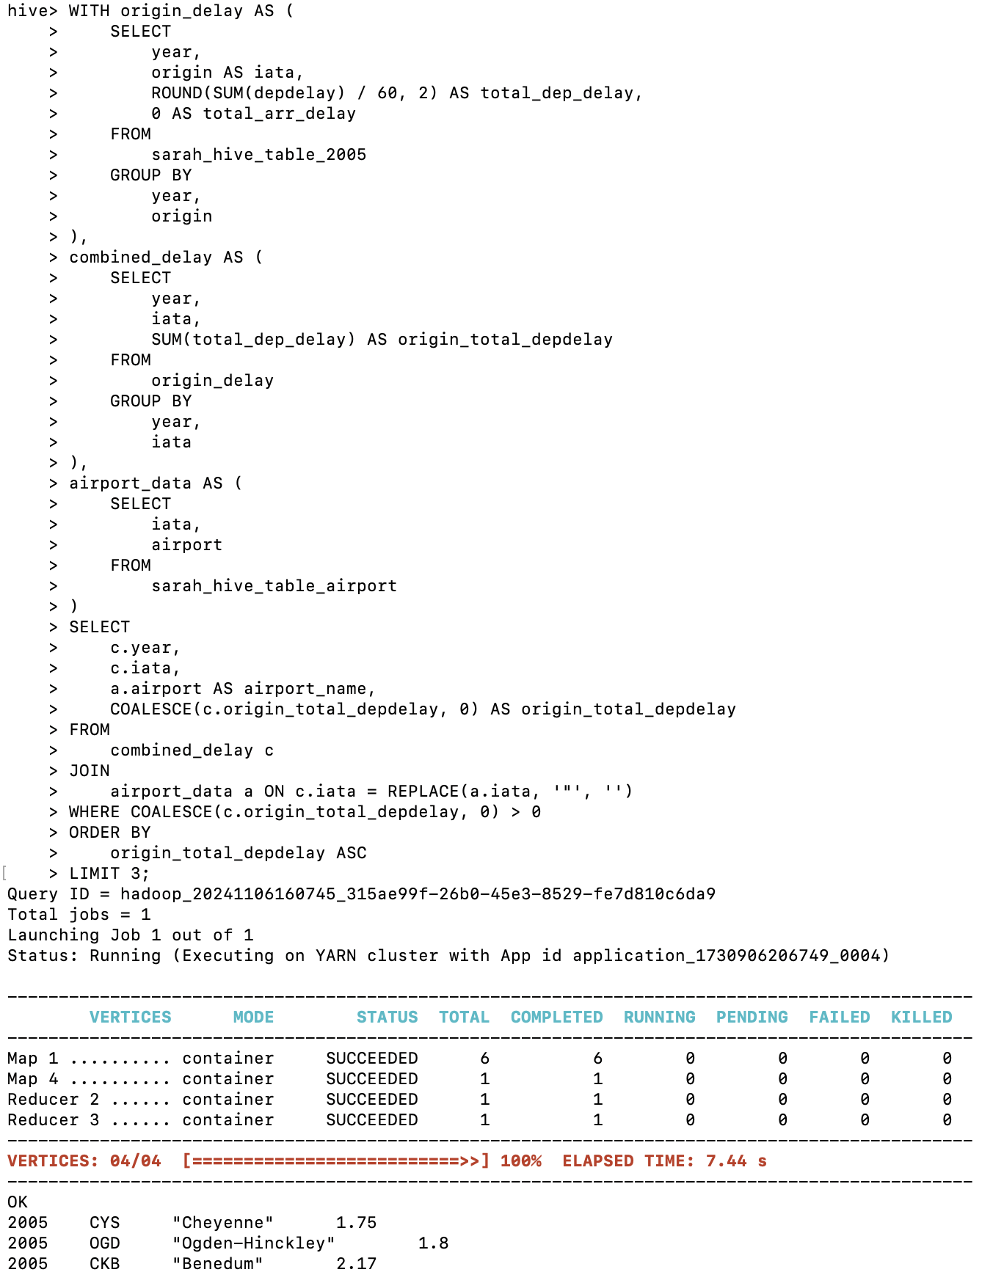
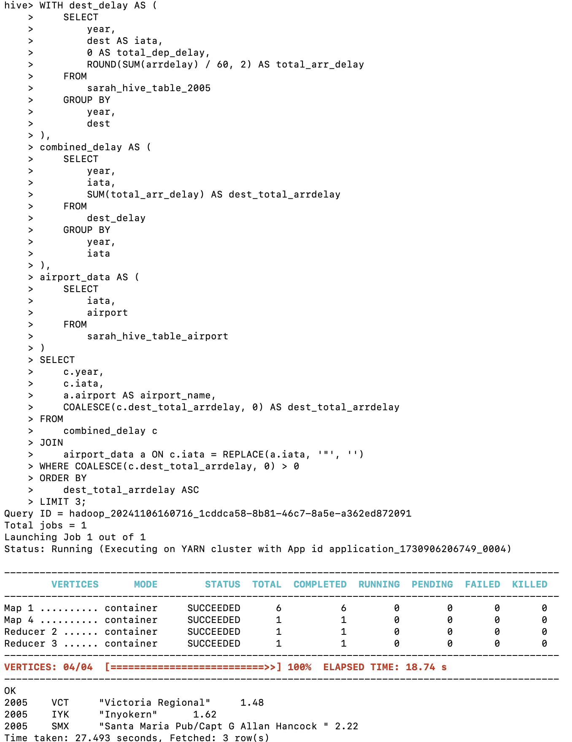
Determine the three airports with the lowest delay time (in hours) for your year
Total Origin dep without arr:
Total Destination delay time without dep:
Notes:
This approach might give you insight into how well airport A is performing in terms of departures while still accounting for arrival delays, but it might not give a complete picture of total delays for the airport itself.

Slide 19
RESULT - The three airports with the lowest delay time (in hours) – FOR ORIGIN
Year | Origin Airport Name | Total Origin Delay (In Hours)
2005 | Cheyenne | 1.75
2005 | Ogden-Hinckley | 1.8
2005 | Benedum | 2.17
These tables provide insights into some of the more reliable airports in 2005, where both departures and arrivals experience lower delays. This analysis can be useful for identifying well-performing airports or for logistical planning in the aviation industry.
RESULT - The three airports with the lowest delay time (in hours) – FOR DESTINATION
Year | Dest Airport Name | Total Dest Delay (In Hours)
2005 | Victoria Regional | 1.48
2005 | Inyokern | 1.62
2005 | Santa Maria Pub/Capt G Allan Hancock | 2.22

Slide 20
SARAH ANNIE GEORGE CASE 2

Slide 21
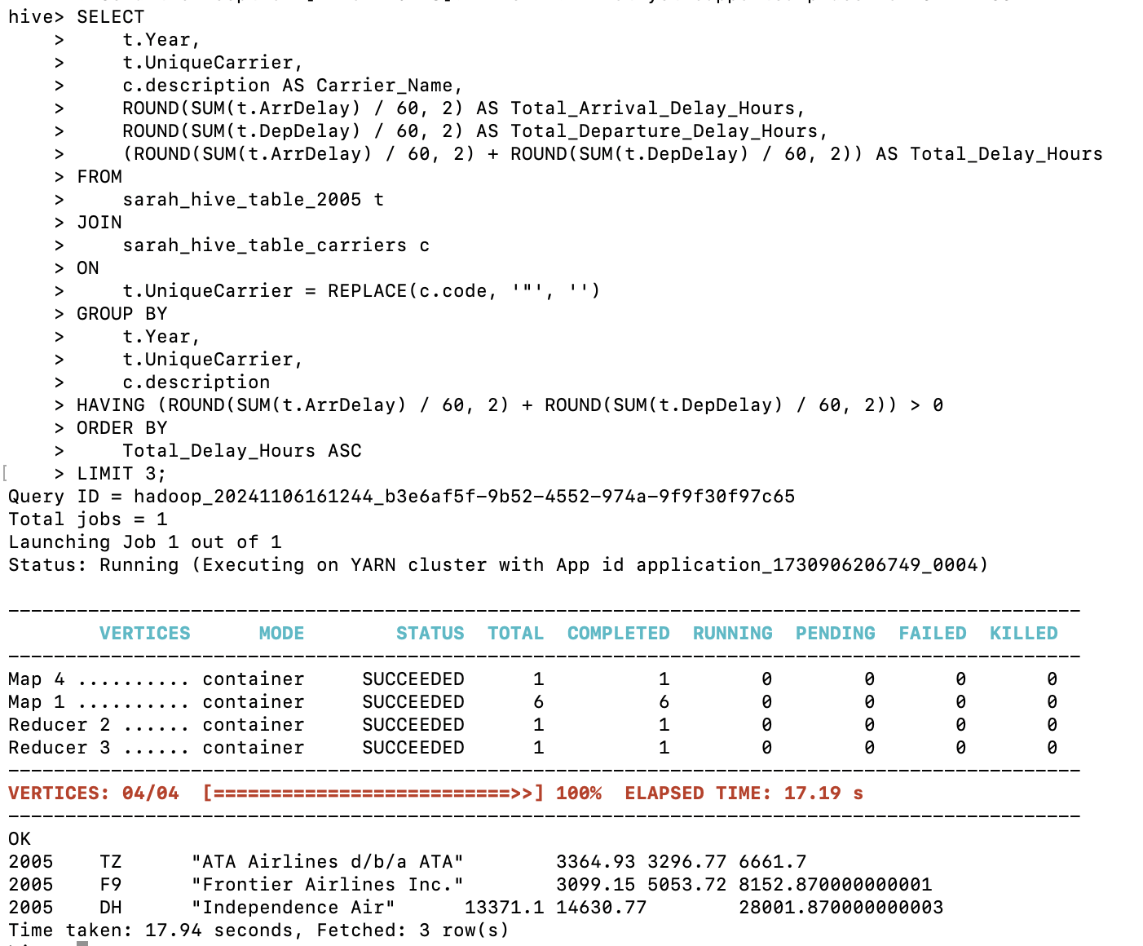
Determine the three carriers with the lowest delay time (in hours)

Slide 22
Result - Top 3 carriers with Lowest Delays for the year 2005 (Displayed in hours)
Year | Airline Name | Arrival Time Delay (In Hours) | Departure time Delay (In Hours) | Total Delay (In Hours)
2005 | ATA Airlines d/b/a ATA | 3364.93 | 3296.77 | 6661.7
2005 | Frontier Airlines Inc. | 3099.15 | 5053.72 | 8152.87
2005 | Independence Air | 13371.1 | 14630.77 | 28001.87
Conclusion: ATA Airlines d/b/a ATA and Frontier Airlines Inc. are the most reliable airlines among these three, with lower delay times. Independence Air may require operational improvements to reduce delays.

Slide 23
SARAH ANNIE GEORGE CASE 3

Slide 24
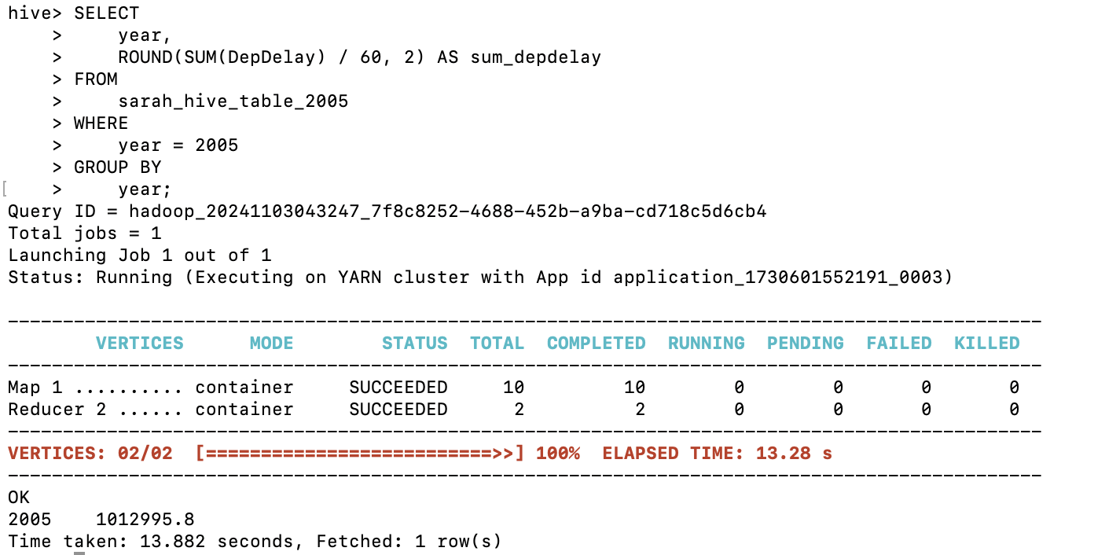
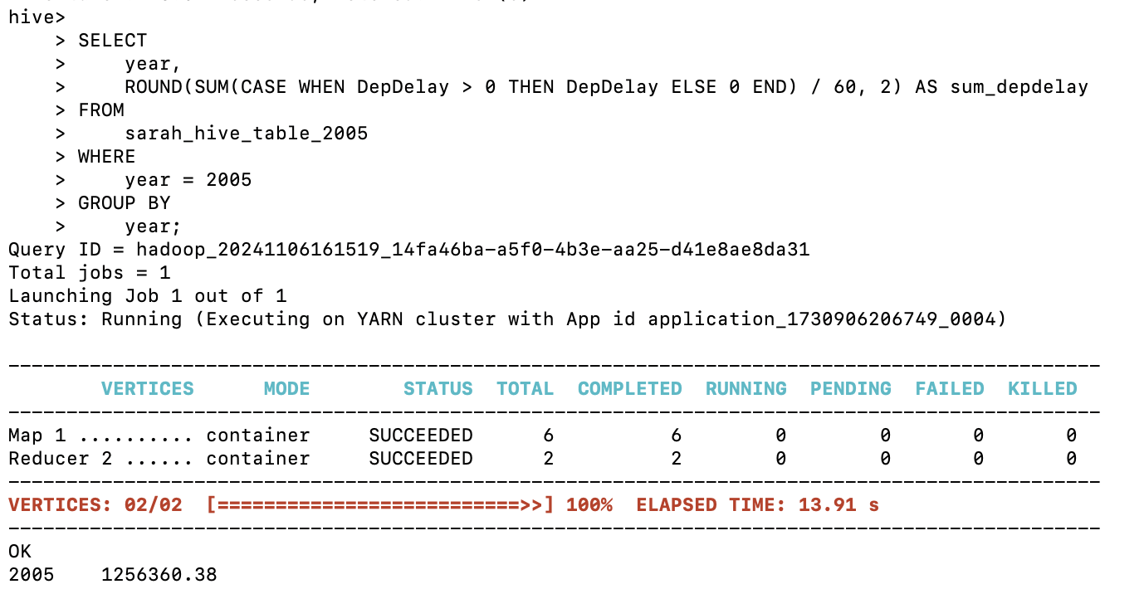
Determine overall, which type of delay is the largest contributor for the year 2005, is it arrivals or departures ?
Overall Departure Delays for 2005
Only with +ve

Slide 25
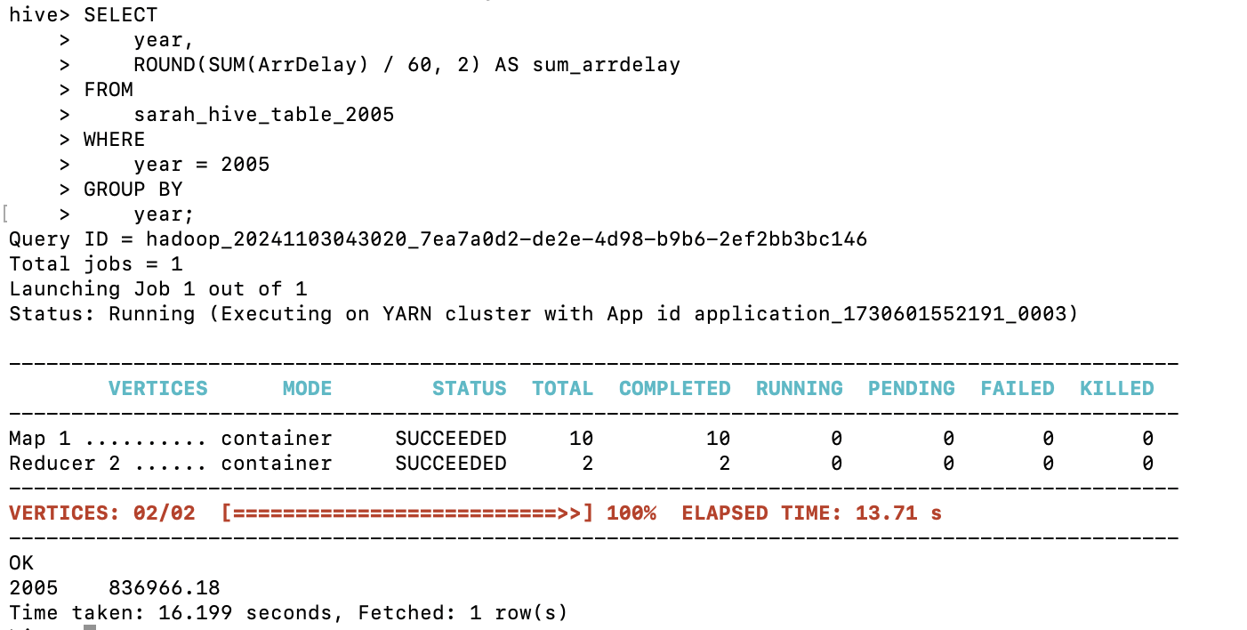
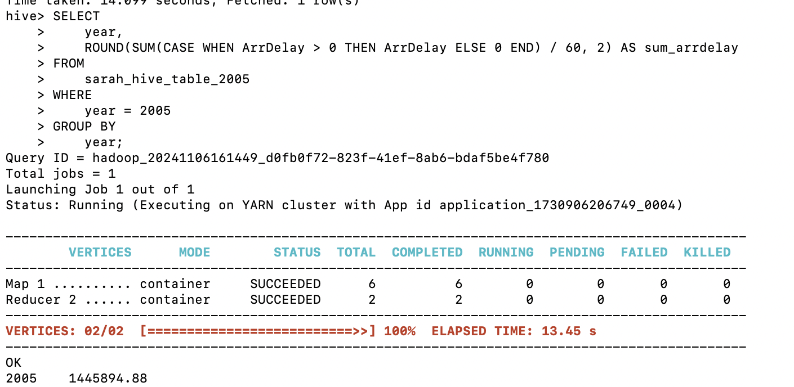
Determine overall, which type of delay is the smallest contributor for the year 2005, arrivals or departures for your airports
Overall Arrival Delays for 2005
Only with +ve nos

Slide 26
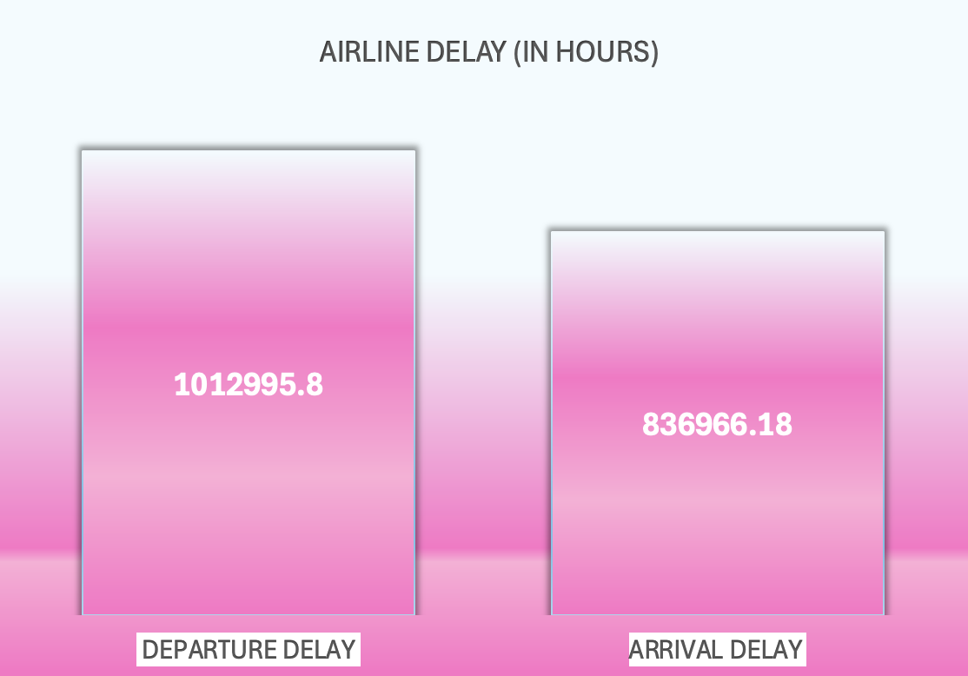
CASE 3: RESULT
Conclusion: Overall Arrival was the smallest contributor for the year 2005

Slide 27
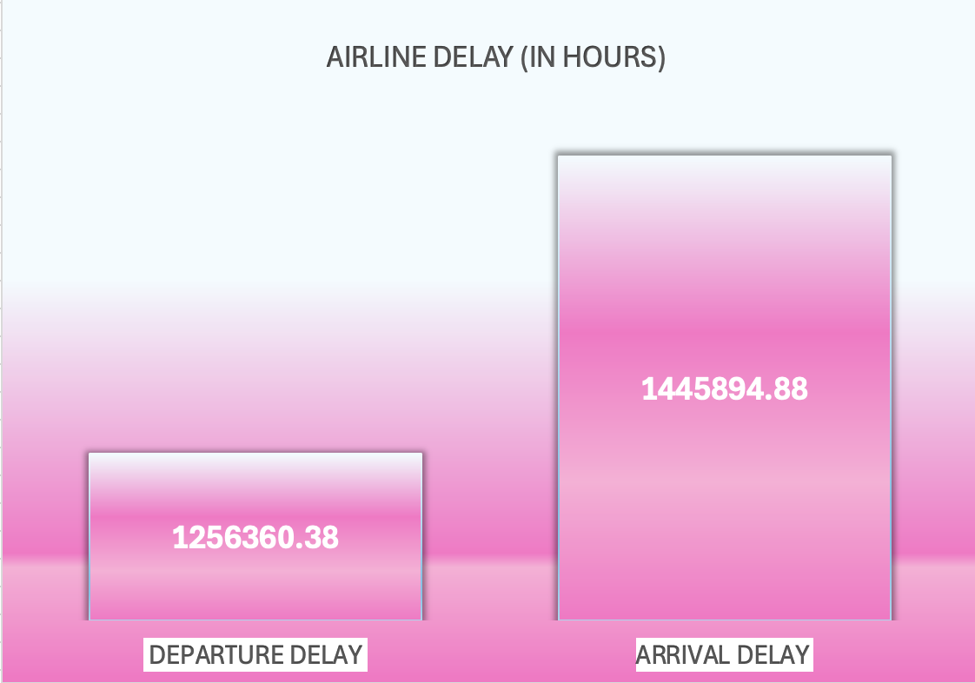
CASE 3: RESULT (only for +ve nos)_
Conclusion: Overall departure was the smallest contributor for the year 2005 if we consider only delays(positive) without considering early delays

Slide 28

Team Conclusion Slides

Slide 29
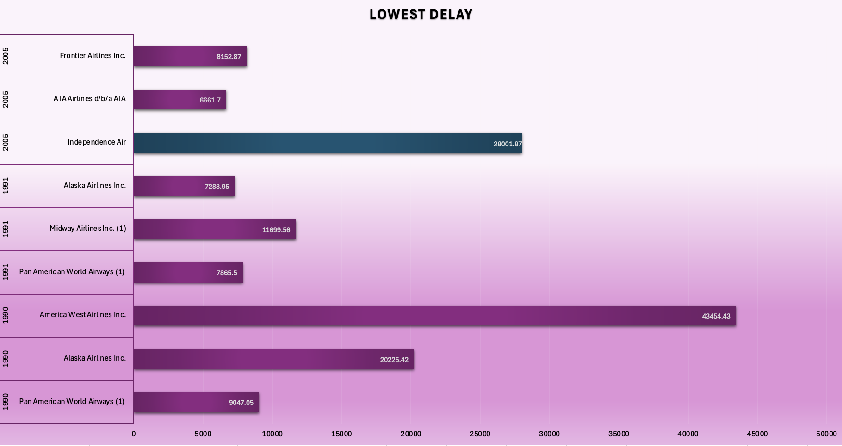
FOR AIRLINES: ATA AIRLINES in 2005 HAD THE LOWEST DELAY
Conclusion:
Airlines in 2005 tend to have lower total delay times compared to earlier years, with ATA Airlines and Frontier Airlines showing relatively better performance.
Airlines like America West in 1990 and Midway Airlines in 1991 show very high delays, indicating that operational challenges were more prominent for these airlines during that period.
Focus on Improvement Needed for Independence Air and Early 1990s Airlines: Independence Air (2005) and the airlines in the early 1990s could benefit from analyzing and improving their operations to reduce delays.

Slide 30
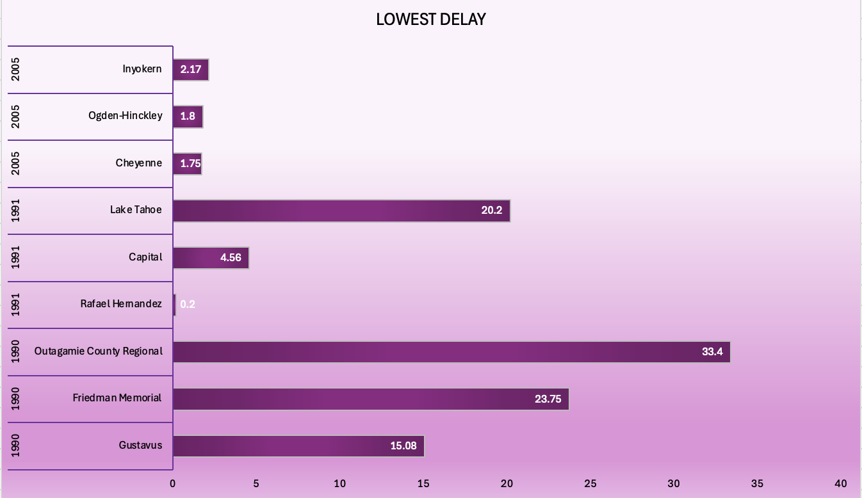
OVERALL DELAY PERFORMANCE BY AIRPORTS: Airport Rafael Hernandez in 1991 Had The lowest Delay time
Conclusion:
In addition to Rafael Hernandez airport in 1991, 2005 Airports Perform Good showing much low delays.
Outagamie County Regional (33.4 hours) and Friedman Memorial (23.75 hours) in 1990, as well as Lake Tahoe (20.2 hours) in 1991, have significantly higher delays.
The lower delays in 2005 and 1991 indicate possible improvements in airport management and efficiency over time, leading to better on-time performance for recent years.

Slide 31
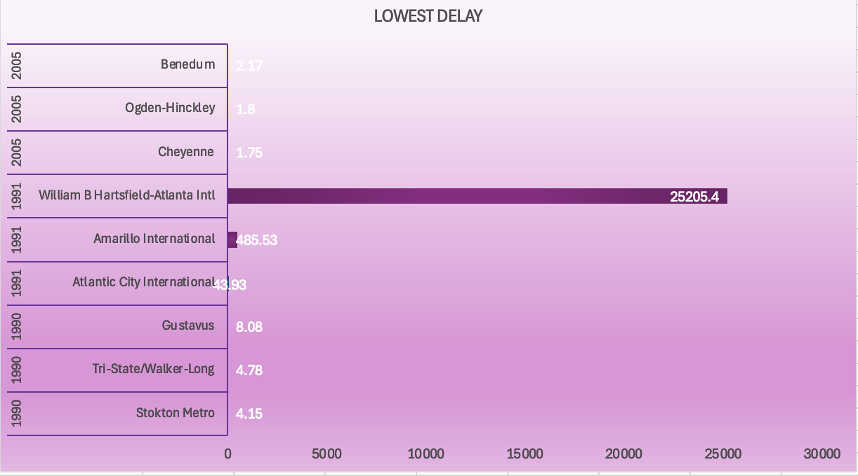
Delay time from the Origin: Airport Cheyenne in 2005 Had The lowest
Delay time
Conclusion:
Flights flying from Cheyenne in 2005 had the least delays and flights flying from William B Hartsfield-Atlanta Intl in 1991 had the most delays

Slide 32
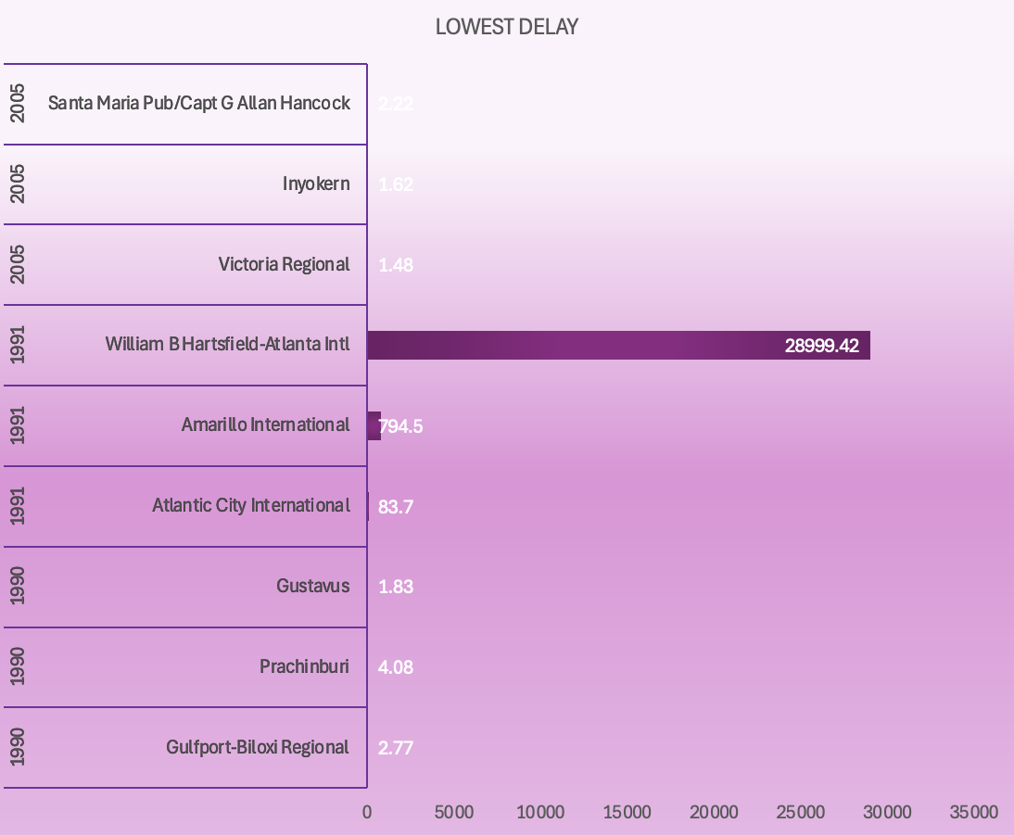
Delay time from the Destination: Airport Victoria Regional in 2005 Had The lowest Delay time
Conclusion:
Flights landing at Victoria Regional airport in 2005 had the least delays and flights landing at William B Hartsfield-Atlanta Intl in 1991 had the most delays
In conclusion William B Hartsfield-Atlanta airport in 1991 had the most origin and destination delays

Slide 33
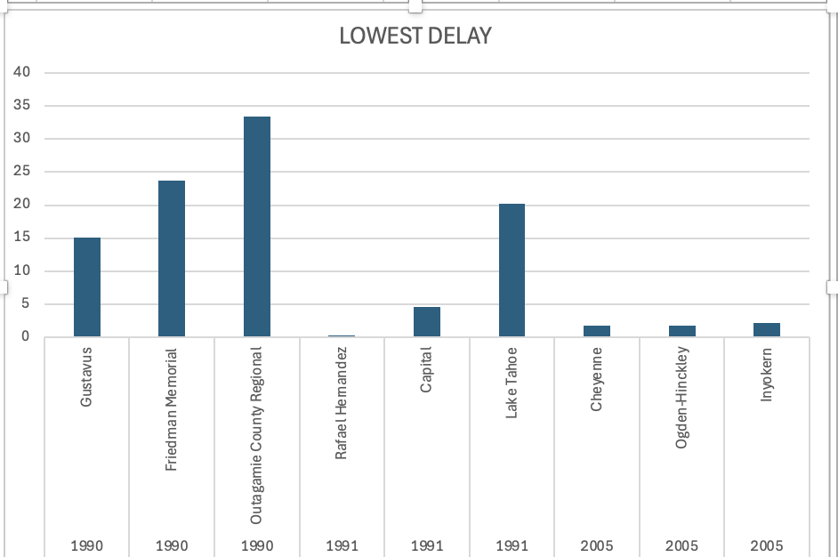
Overall delay performance Analysis of Airports by the year
Conclusion: We can see how the delays are through the years. 2005 has been the best year with the lowest delays overall. Airports from 1990 (like Outagamie County Regional) show significantly higher delays than airports from 2005 (like Cheyenne, Ogden-Hinckley, and Inyokern), which may indicate an improvement in delay management over the years. High delays can point to factors such as location, traffic volume, or operational efficiency affecting delay times.

Slide 34

Thank you! Any questions?

